Slide 1
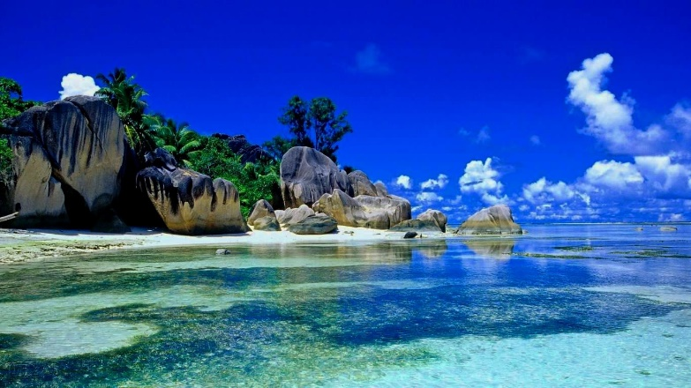
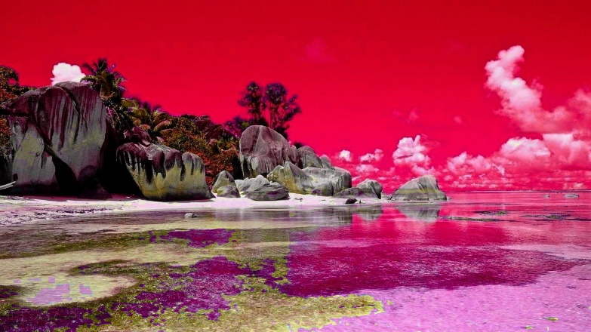
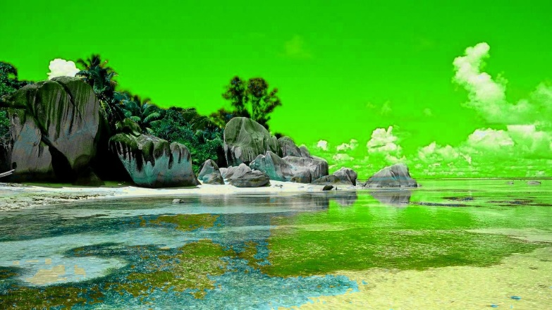
Image Color Theme Enhancement
- Gaurav Patil

Slide 2
Introduction
Editing the color composition of an image to enhance a color theme can be a painful experience
Powerful commercial software, such as Photoshop, does not explicitly support color theme editing
A desired approach to automate color editing according to a user-desired theme
While respecting natural textures and leaving sufficient control to users

Slide 3
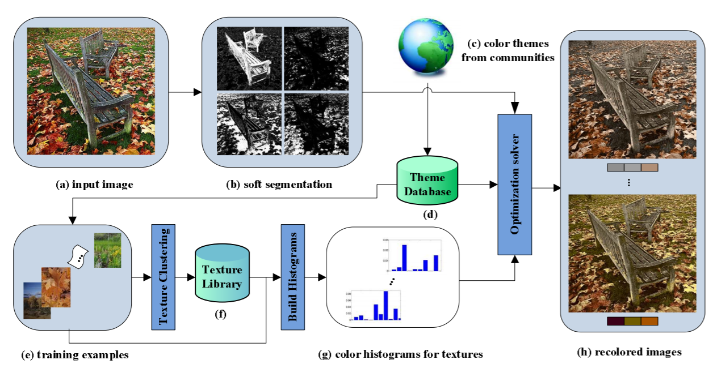
Method

Slide 4
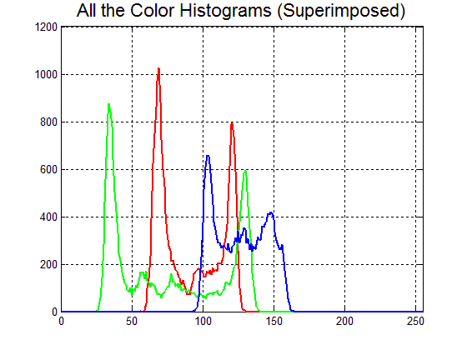
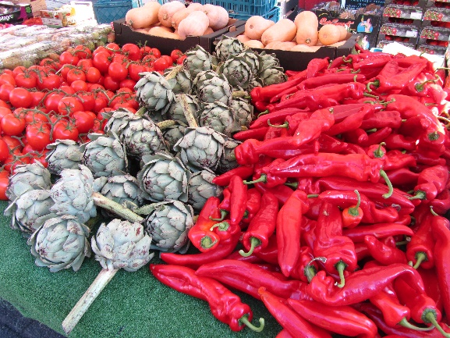
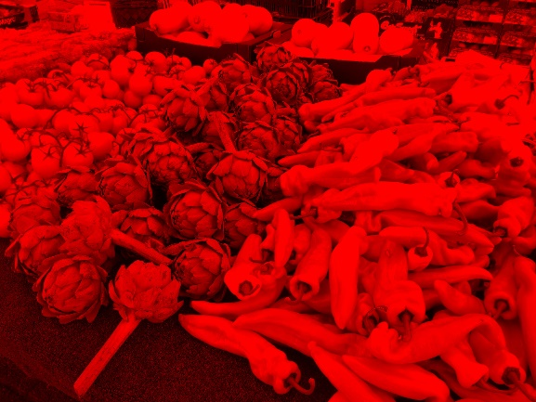
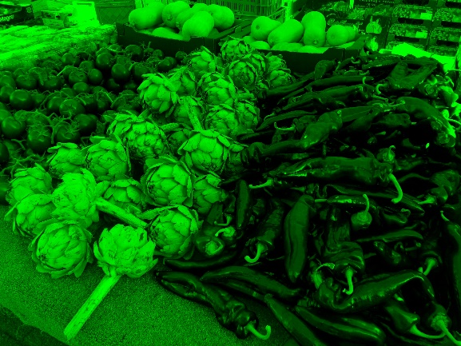
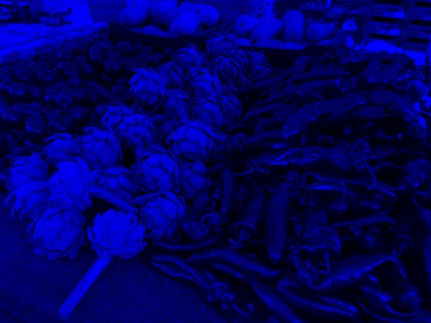
Experiment
red = image( :, :, 1) % Red channel
green = image( :, :, 2) % Green channel
blue = image( :, :, 3) % Blue channel
a = zeros( size( image, 1), size (image, 2))
Just - red = cat( 3, red, a, a)
Just - green = cat( 3, a, green, a)
Just - blue = cat( 3, a, a, blue)
Original
Red Channel
Green Channel
Blue Channel

Slide 5
Experiment
Theme 1:
if ( RGB(i,j,2) > RGB(i,j,1) && RGB(i,j,2) > RGB(i,j,3) )
x = RGB(i,j,2);
RGB(i,j,2) = RGB(i,j,3);
RGB(i,j,3) = RGB(i,j,1);
RGB(i,j,1) = x;
else if( RGB(i,j,3) > RGB(i,j,1) && RGB(i,j,3) > RGB(i,j,2) )
y = RGB(i,j,3);
RGB(i,j,3) = RGB(i,j,2);
RGB(i,j,2) = RGB(i,j,1);
RGB(i,j,1) = y;

Slide 6
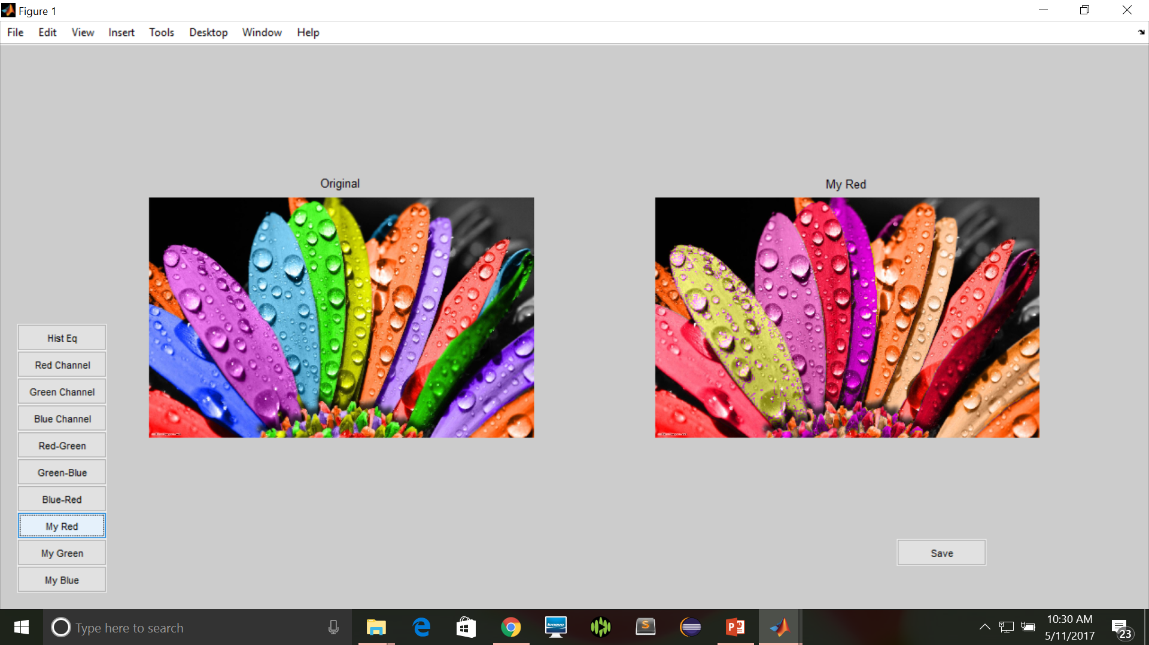
User Interface

Slide 7
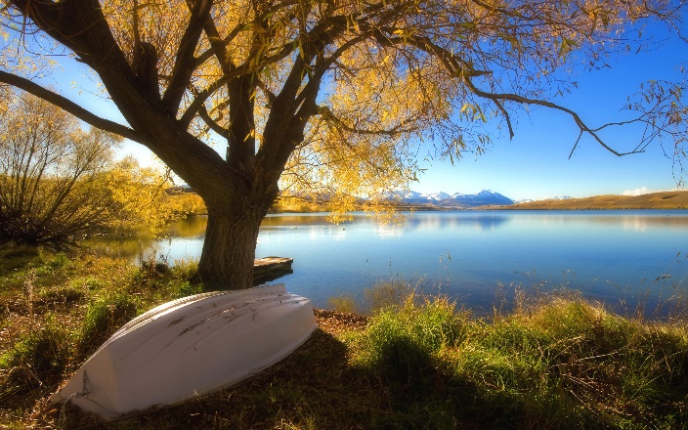
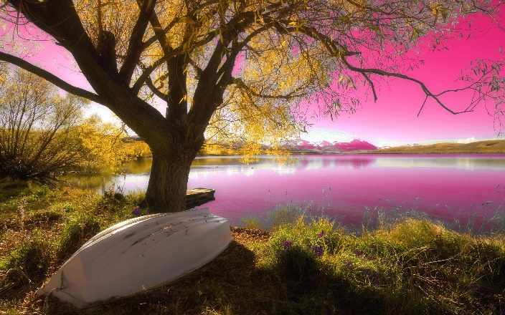
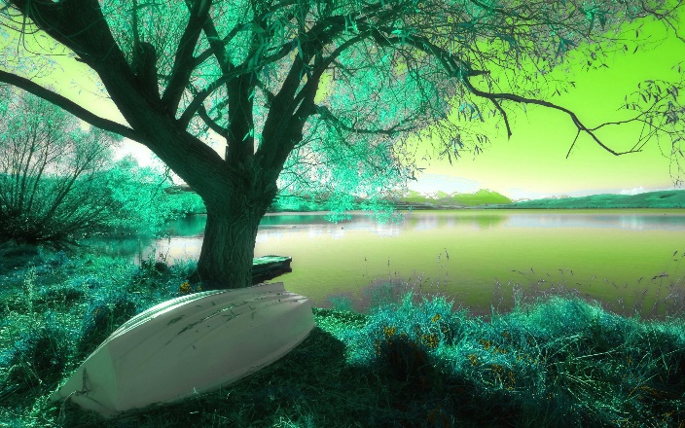
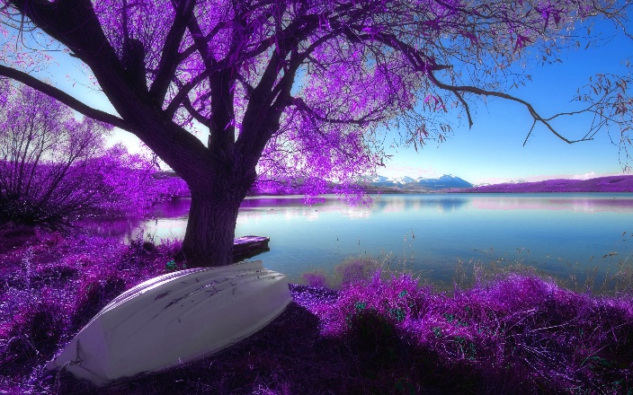

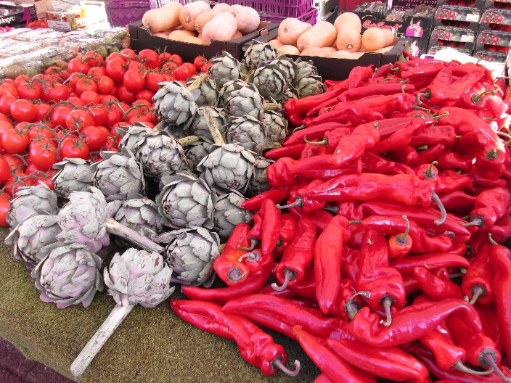
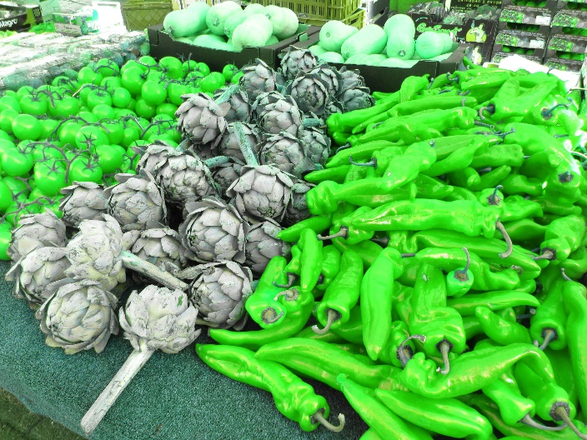
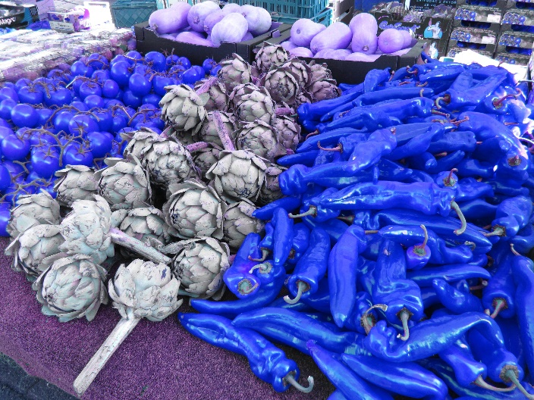
Results
Original
Theme 1
Theme 2
Theme 3
Original
Theme 1
Theme 2
Theme 3

Slide 8
Author’s Conclusion
Have presented an example-based method for steering the color composition of an image towards a desired color theme impression
Formulated the goal that considers a desired color theme, texture-color relationships as well as color constraints

Slide 9
Conclusion
Have tried to get the results same as the Research Paper by changing the color theme of an image while respecting natural textures and leaving sufficient control to users

Slide 10
Thank You

